Slide 1
Group #2 Milestone #7

Slide 2
Scope
Milestone #1 | Importance of Big Data Security Big Data Security Technologies
Milestone #2 | Big Data Security Risk
Milestone #3 | Big Data Security Use Cases
Milestone #4 | Big Data Security Issues Regulations and Policies
Milestone #5 | Implementation Part 1
Milestone #6 | Implementation Part 2
Milestone #7 | Implementation Part 3

Slide 3
Agenda
Discuss the Seventh Milestone
Discuss about Ubuntu Security Configuration
Discuss about Hadoop Security Configuration
Discuss about Kerberos Authentication
Discuss about Cassandra Security Configuration
Conclusion
Notes:
Notes:
References:

Slide 4
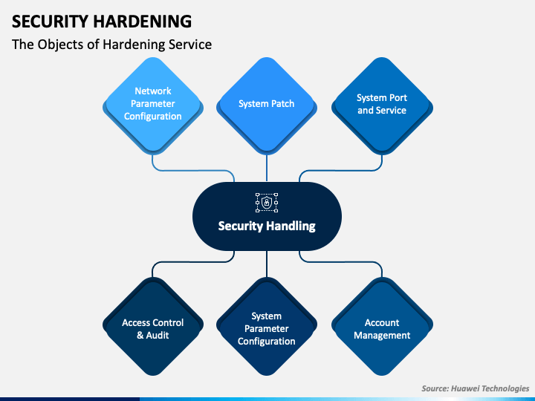
Ubuntu Security Configuration
Complex Password
Disk Encryption
Setup Non-Root User
Secure SSH
Install Anti-Virus
https://www.edureka.co/blog/interview-questions/cassandra-interview-questions/
Notes:
Notes:
In our previous implementations, we have successfully managed to set up our Ubuntu System on a Virtual Machine. During the Ubuntu installation, we employed some security measures to prevent any unauthorized access to our System.
We have password protected our Ubuntu system with a complex password to ensure security.
Moreover, we have encrypted the system disk to prevent any data theft even if someone steals the hardware itself.
Then we created a non-root user to set up the Hadoop, Spark and Cassandra packages in order to avoid working as a Root User in case the account is compromised.
We even configured a Password-less authentication over SSH to prevent password guessing attacks.
One more thing we would like to add to these security measures is the use of an Anti-Virus program. There are various Anti-Virus programs readily available in the market ranging from free to commercial products.
We would like to recommend ClamAV as it is a popular open-source Anti-Virus solution.
We successfully secured our Ubuntu system in previous weeks, but you might have noticed the obvious lack of security implementation in our Hadoop and Cassandra systems. Anyone logged in to the Ubuntu System can easily access and manipulate the HDFS and Cassandra databases. Let us fix this now.
References:
Medic, Z. (2021, January 7). Security Hardening Ubuntu 20.04. IT Blog. https://www.informaticar.net/security-hardening-ubuntu-20-04/

Slide 5
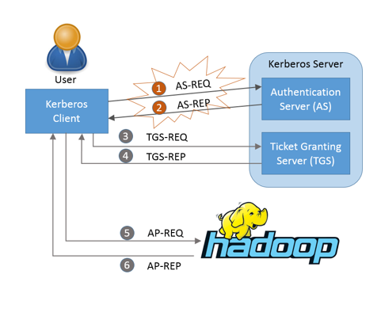
Hadoop Security Configuration
Transparent Encryption
Turned off by default
Enable Hadoop Authentication
Kerberos Security
https://software.intel.com/content/www/us/en/develop/articles/big-data-security-solution-based-on-kerberos.html
Notes:
Notes:
HDFS offers transparent, end-to-end encryption. This, however, is turned off by default. Once configured, data read from and written to special HDFS directories is transparently encrypted and decrypted without requiring changes to user application code. This encryption is also end-to-end, which means the data can only be encrypted and decrypted by the client. HDFS never stores or has access to unencrypted data or unencrypted data encryption keys. This satisfies two typical requirements for encryption: at-rest encryption (meaning data on persistent media, such as a disk) as well as in-transit encryption (e.g., when data is travelling over the network).
To create secure communication among its various components, HDP uses Kerberos. Kerberos is a third-party authentication mechanism, in which users and services that users wish to access rely on the Kerberos server to authenticate each to the other. This mechanism also supports encrypting all traffic between the user and the service. In order to implement this, we must first set up Kerberos server on our system. To enable this feature, it is mandatory to have Kerberos set up on the machine.
References:
Cloudera. (n.d.). Kerberos Overview - Hortonworks Data Platform. Cloudera Docs. Retrieved July 23, 2021, from https://docs.cloudera.com/HDPDocuments/HDP2/HDP-2.3.4/bk_Security_Guide/content/kerberos-overview.html
Apache. (n.d.). Apache Hadoop 3.3.1 – Transparent Encryption in HDFS. Apache Foundation. Retrieved July 23, 2021, from https://hadoop.apache.org/docs/current/hadoop-project-dist/hadoop-hdfs/TransparentEncryption.html

Slide 6
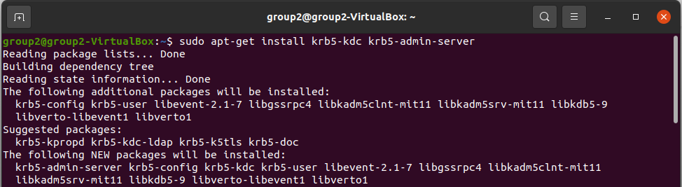
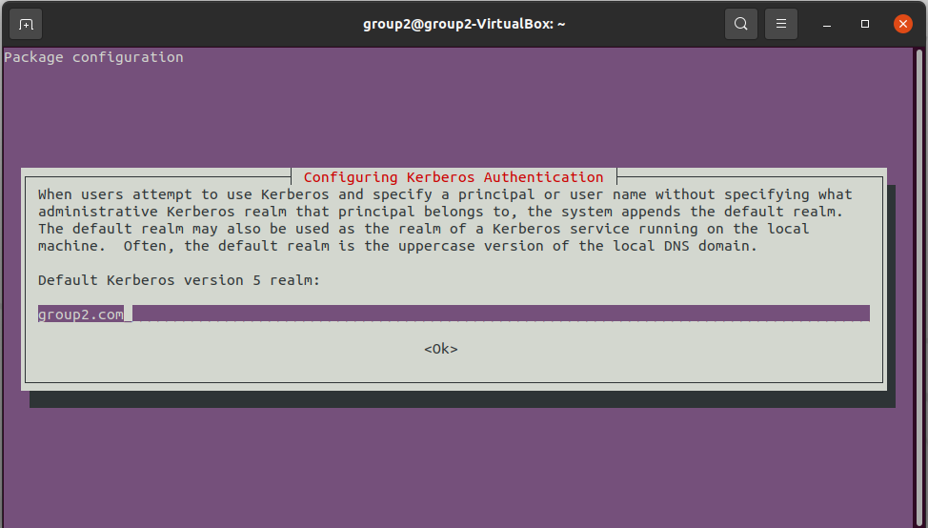
Installing Kerberos Server
Configure hostname for localhost
Install Kerberos Admin Server
Setup your Realm
Specify the hostname for Kerberos Server and Admin Server
Installation Complete
Notes:
Notes:
First, we need to specify a hostname for our localhost as hadoop in the /etc/hosts files. Then we proceed towared installing Kerberos Admin Server on the System.
Execute the following command to start the installation: sudo apt-get install krb5-kdc krb5-admin-server
During the setup, you will be asked to setup your Default Realm. A realm is a kind of node which is very similar to a domain. You can see the realm name that we entered in the screenshot. Then you will be asked to specify the host name for the admin and server, which is the same one we entered in at the beginning, .i.e., Hadoop.
This will conclude the installation.
References:
Tokluo. (2016, January 26). Secureing Hadoop. My Tech Blog. https://tokluo.wordpress.com/2016/01/26/secureing-hadoop/

Slide 7
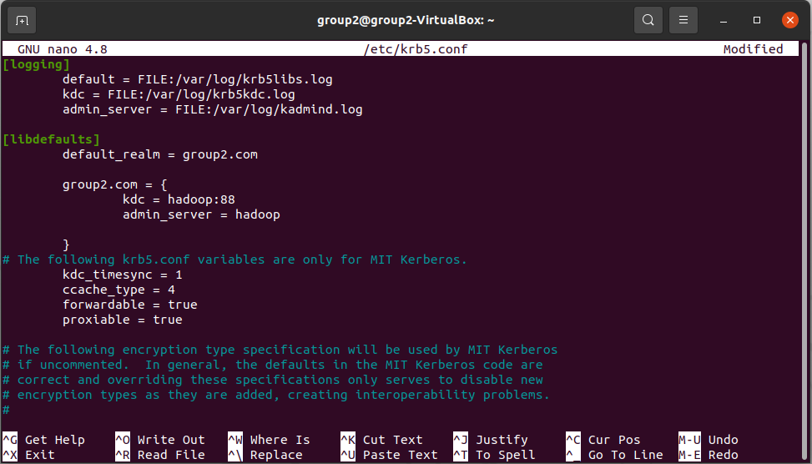
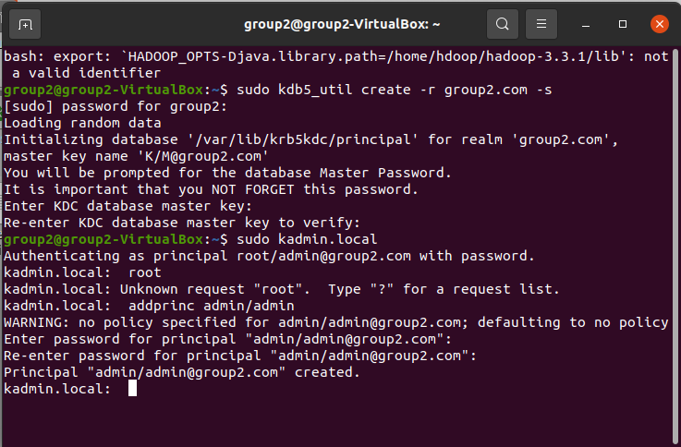
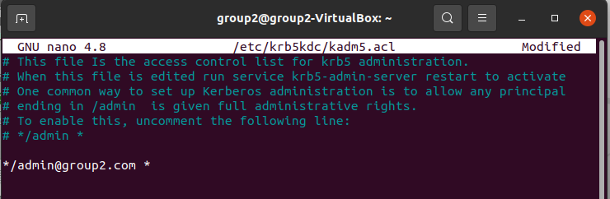
Configuring Kerberos Server
Open /etc/krb5.conf
Add the logging details
Add the realm details
Initialize the realm
Setup your KDC Server Master Key
Specify the admin in Kerberos ACL
Notes:
Notes:
Now comes the hard part, we now need to configure the Kerberos server before we connect it to Hadoop. First open the /etc/krb5.conf and add the log and realm details as shown in the first screenshot.
Then we initialize the realm using these two commands:
sudo krb5_newrealm
sudo /etc/init.d/krb5-kdc restart
During this, you will be asked to specify the master password for Kerberos, please choose a strong password and never forget it or things may get complicated.
Once that is done, we need to enter the admin in Kerberos’ Access Control List (ACL). To do that, edit the file /etc/krb5kdc/kadm5/acl and enter the admin details as shown in the third screenshot.
References:
Tokluo. (2016, January 26). Secureing Hadoop. My Tech Blog. https://tokluo.wordpress.com/2016/01/26/secureing-hadoop/

Slide 8
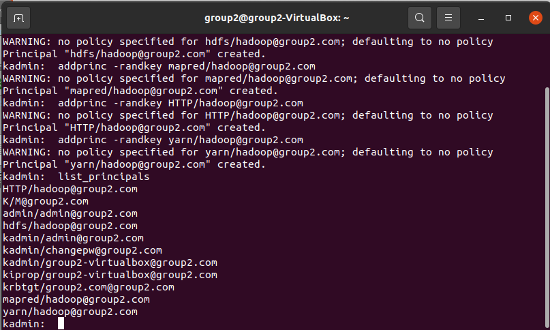
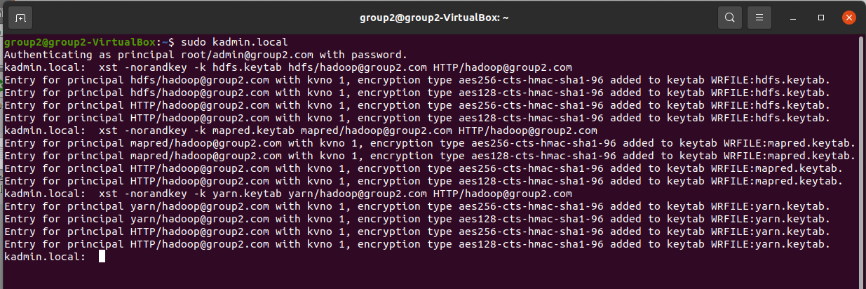
Create Kerberos Database
Create the new database
Add Admin principal for Database
Add principal for HDFS Service
Add principal for MapReduce Service
Add principal for HTTP Service
Add principal for YARN Service
Generate and store the keytabs for all services
Notes:
Notes:
Now we need to create the Database for Kerberos. Use the following commands:
sudo kdb5_util create -r group2.com -s
sudo kadmin.local
kadmin.local: addprinc admin/admin
After that, please restart the admin server using the following command:
sudo service krb5-admin-server restart
Now log in to the admin server and add the principals for all the specified services using the following commands:
addprinc -randkey hdfs/hadoop@group2.com
addprinc -randkey mapred/hadoop@group2.com
addprinc -randkey HTTP/hadoop@group2.com
addprinc -randkey yarn/hadoop@group2.com
Once the principals are added, generate the keytabs for each service principals using the code below and store it in a safe location. This will be used for authentication later.
xst -norandkey -k hdfs.keytab hdfs/hadoop@group2.com HTTP/hadoop@group2.com
xst -norandkey -k mapred.keytab mapred/hadoop@group2.com HTTP/hadoop@group2.com
xst -norandkey -k yarn.keytab yarn/hadoop@group2.com HTTP/hadoop@group2.com
References:
Tokluo. (2016, January 26). Secureing Hadoop. My Tech Blog. https://tokluo.wordpress.com/2016/01/26/secureing-hadoop/

Slide 9
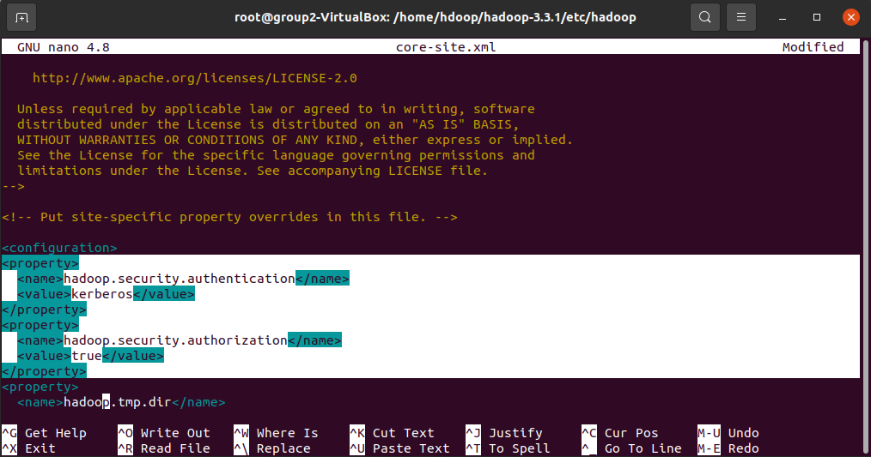
Configure Hadoop for Kerberos
Append the code provided in the Project resources for each of the following:
core-site.xml
yarn-site.xml
hdfs-site.xml
mapred-site.xml
Restart Hadoop Cluster
Notes:
Notes:
Now we have successfully configured the Kerberos Server and we are ready to integrate it with Hadoop for authentication. This part will be straightforward, but you are required to carefully read each settings as you might have to change some code according to your own system such as pathnames and hostname.
We are required to append security configuration in each of these configuration files in the Hadoop package as shown in the example screenshot:
core-site.xml
yarn-site.xml
hdfs-site.xml
mapred-site.xml
We will be providing our configured files in the project package for reference, please check it out and configure your system accordingly.
References:
Tokluo. (2016, January 26). Secureing Hadoop. My Tech Blog. https://tokluo.wordpress.com/2016/01/26/secureing-hadoop/

Slide 10
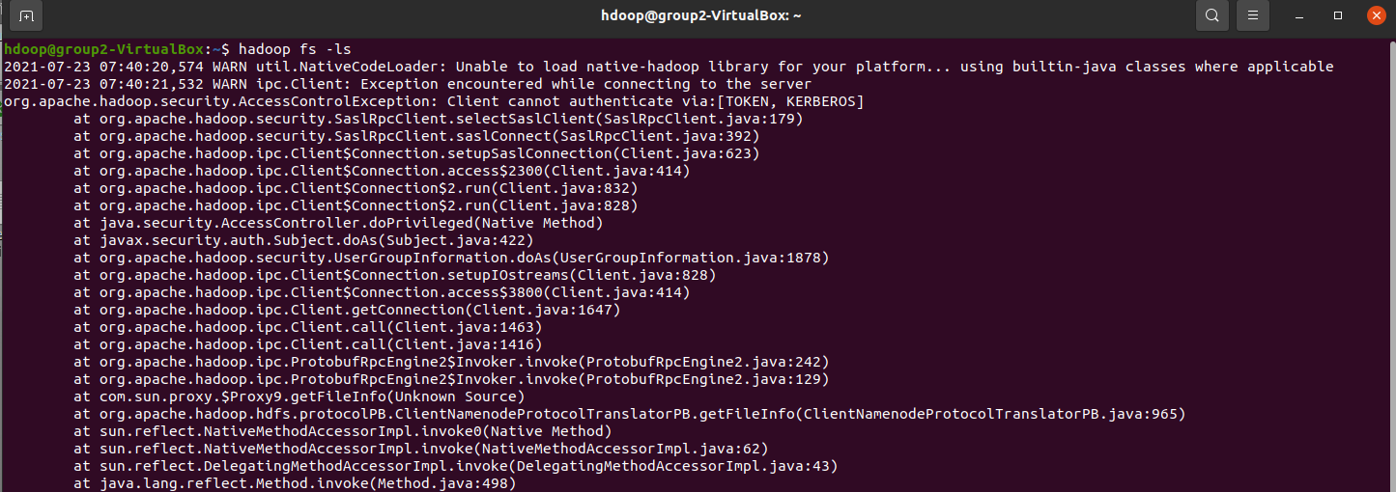
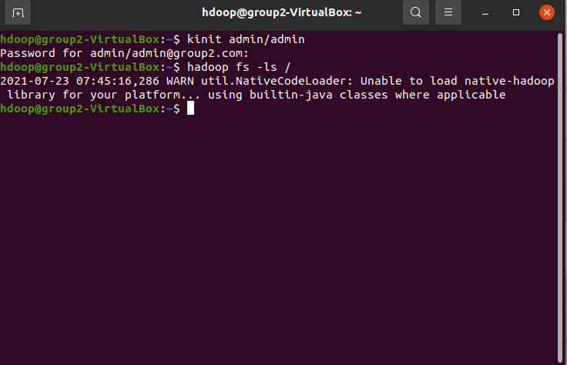
Testing Hadoop Authentication
Try accessing Hadoop normally.
You will encounter an Access Control Exception.
Now authenticate using Kerberos Server.
Try accessing Hadoop again.
You will see no errors.
Notes:
Notes:
Now our Kerberos Server has been integrated to our Hadoop Cluster, and we are ready to test the security.
Let us try to access Hadoop like we did previously, without any authentication.
First start the Hadoop Server and try listing any Hadoop Data using hadoop fs –ls / command.
It is true that we have not added any data to our system. But still the authentication service should deny this request no matter what. As you will see that you will encounter an error with Access Control Exception.
Now let us authenticate to our Kerberos Server using the following command:
kinit admin/admin
It will ask for the master password, enter the password that you specified before. If you enter the correct password, you will be issued a ticket by Kerberos System.
Try accessing the Hadoop Data again, you will notice that this type you won’t face any error and if you have any data, it will be displayed.
References:
Tokluo. (2016, January 26). Secureing Hadoop. My Tech Blog. https://tokluo.wordpress.com/2016/01/26/secureing-hadoop/

Slide 11
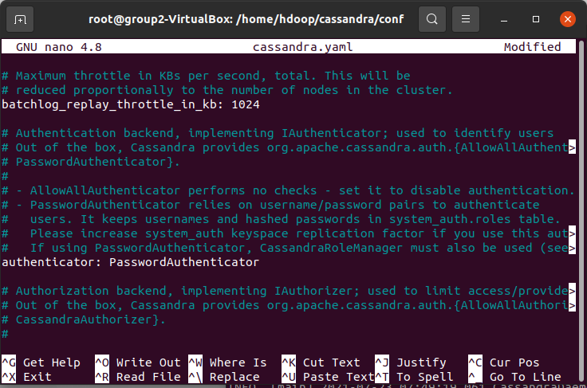
Cassandra Authentication Configuration
What is Cassandra Authentication?
Edit cassandra.yaml file
Specify authenticator:
PasswordAuthenticator
Restart Cassandra Service
Notes:
Notes:
Now that we have secured our Hadoop System, we also need to secure our Cassandra data as well. Unlike Hadoop, Cassandra provides a built-in authentication mechanism which is disabled by default.
In order to enable it, we need to edit the cassandra.yaml file in the Cassandra Package.
In the file, you will find an authenticator field, you have to set it to PasswordAuthenticator. And that is the only thing we must do. Restart Cassandra service to apply the settings
References:
Datastax. (n.d.). Configuring authentication. Retrieved July 23, 2021, from https://docs.datastax.com/en/cassandra-oss/3.0/cassandra/configuration/secureConfigNativeAuth.html

Slide 12
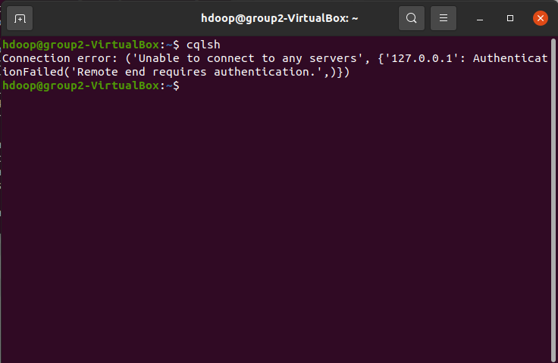
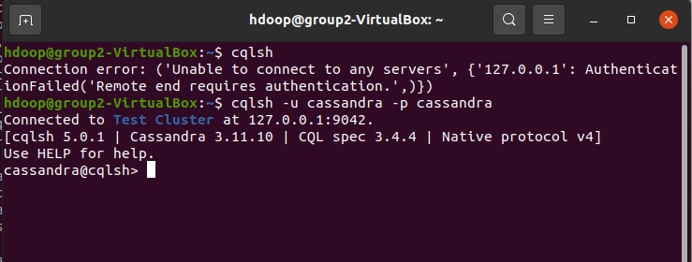
Testing Cassandra Authentication
Start Cassandra Service.
Try starting cqlsh normally.
You will encounter an authentication error
Now try starting cqlsh with –u and –p as username and password parameters
Access will be granted
Notes:
Notes:
Now let us test this, try to run the CQL Shell as usual.
Again, you will encounter an authentication error. You are required to provide username and password when you try to access the CQL Shell. The default username:password for Cassandra is cassandra:cassandra.
Use the following command to authenticate and access CQL Shell:
cqlsh –u cassandra –p cassandra
This time you will be able to access CQL Shell
The password can be easily changed in the Cassandra shell and other users can also be created/modified/deleted.
References:
Datastax. (n.d.). Configuring authentication. Retrieved July 23, 2021, from https://docs.datastax.com/en/cassandra-oss/3.0/cassandra/configuration/secureConfigNativeAuth.html

Slide 13

Conclusion
In this way, we have successfully implemented authentication mechanism for both Hadoop and Cassandra. This will make sure that the data inside the system is secured. If you want to further increase the security of the system, you can also implement Apache Knox and Apache Ranger.
Finally, no matter how complex and strong our system security is, it will be useless if our employees are careless enough to leave credentials on their desks. Hence, security conscious mindset is the best protection against Cyber Attacks.
https://riis.com/blog/cloud-security/
Notes:
Notes:
References:

